Slide 1

CMR COLLEGE OF ENGINEERING & TECHNOLOGY
Kandlakoya, Medchal, Hyderabad - 501401
Department of Computer Science & Engineering
CNN-Based Poem Learning & Interpretation Inspired by Human Rote Learning
Batch No – B45
Student Details:
22H51A0586- G.Maneendra
22H51A05A1- M.Kavya
22H51A05A4- M.Manoj
Under esteemed guidance of
Dr.S.Siva Skandha
Ms.W.Sangeeta

Slide 2
Contents
Introduction
Literature Review
Problem Definition
Proposed Solution
Conclusion
Notes:
2

Slide 3
Introduction
Poetry is rich in structure, style, rhythm, and meaning, making it complex for automated understanding.
Humans memorize and interpret poems through repeated reading (rote learning), internalizing patterns and nuances.
Deep learning, particularly CNNs, can mimic this process by detecting both local patterns (like rhyme and repetition) and global abstractions (like style and rhythm).
The project explores how AI can learn, recognize, and interpret poems in a manner inspired by human memory and learning.
Notes:
3

Slide 4
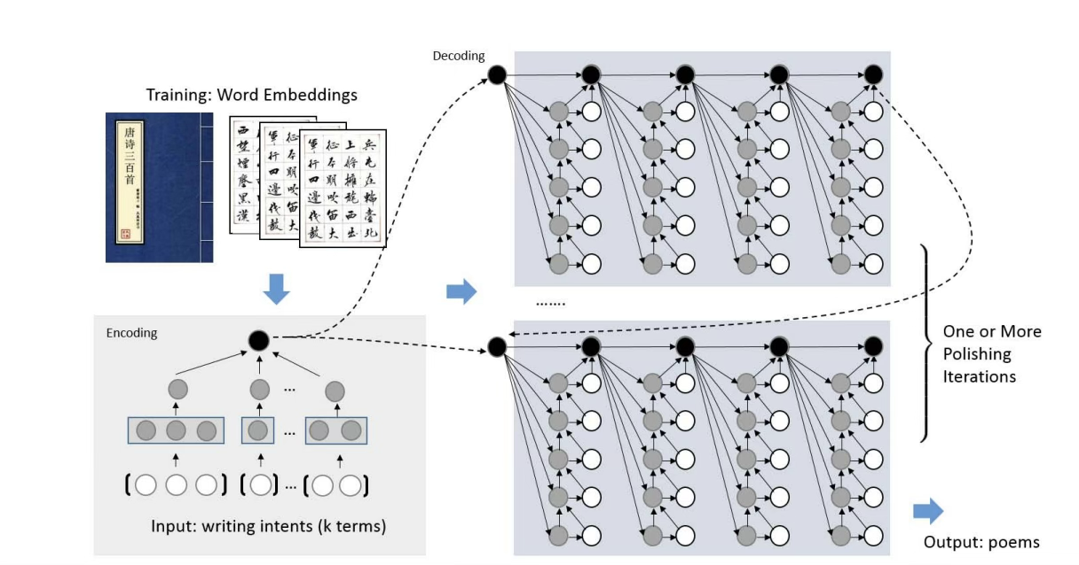
Literature Survey - 1
Authors: Rui Yan, Cheng-Te Li, Xiaohua Hu, Ming Zhang, Yalong Guo
Journal / Conference : Proceedings of the 25th International Joint Conference on Artificial Intelligence (IJCAI 2016)
Publisher / Year: AAAI Press / 2016
Notes:
4

Slide 5
Literature Survey - 1
Summary :
iPoet is a deep learning-based poetry generator for Chinese classical poems.
Takes user-provided keywords or intent as input to guide poem generation.
Uses a hierarchical RNN architecture:
Line-level RNN plans overall poem structure.
Character-level RNN generates each line word-by-word.
Introduces an iterative “polishing” mechanism to refine drafts over multiple passes.
Mimics how human poets revise to improve fluency, coherence, and thematic consistency.
Trained on a large corpus of Tang and Song dynasty poems.
Achieved superior performance in BLEU, perplexity, and human evaluations.
Notes:
5

Slide 6
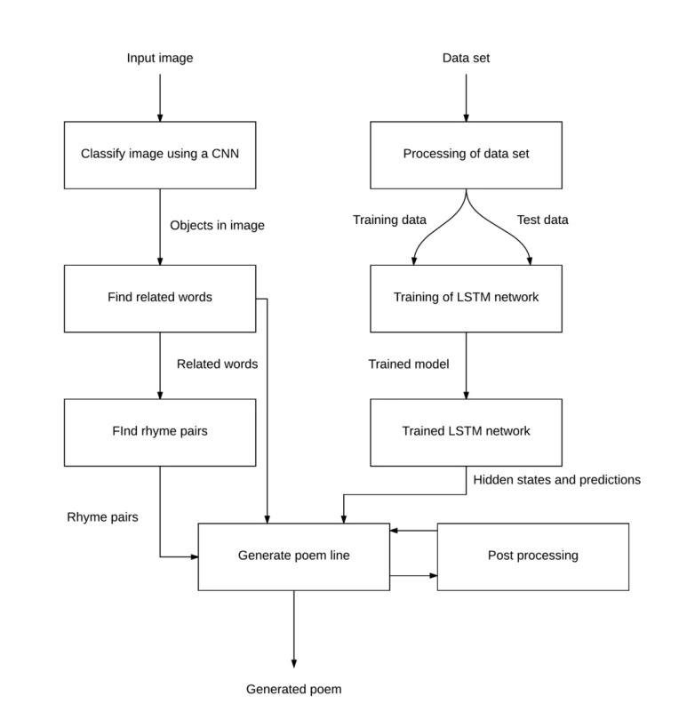
Literature Survey - 2
POEM: Deep Learning-based Poetry Generation Given Visual Input
Authors: Malte Loller-Andersen and Björn Gambäck
Journal / Conference: Proceedings of the 9th International Conference on Computational Creativity (ICCC 2018)
Publisher / Year: Association for Computational Creativity (ACC), 2018
Notes:
6

Slide 7
Literature Survey - 2
Summary:
Proposes a deep learning system that generates poems from images.
Integrates Computer Vision and Natural Language Generation for artistic output.
Uses a CNN (ImageNet-pretrained) to extract visual features.
Features are input to an LSTM that generates poetic lines word-by-word.
Trained on image–poem pairs to learn visual–linguistic relationships.
Beam search decoding improves fluency and creativity.
Cross-entropy loss and word embeddings ensure semantic accuracy.
Produces syntactically correct, image-relevant poems but lacks emotional depth.
A pioneering step toward multimodal creativity, inspiring later models like CLIP, BLIP, GPT-4V.
Notes:
7

Slide 8
Problem Definition
1. Difficulty in Poem Comprehension:
Traditional NLP models struggle to grasp poetic structure, metaphors, and emotions — leading to poor interpretation accuracy.
2. Human-Like Learning Gap:
AI models lack the repetitive reinforcement humans use in rote learning, essential for memorization and deep understanding.
3. Lack of Structural Awareness:
Poems contain rhythmic, rhyming, and visual patterns ignored by text-only models. CNNs can capture these local spatial/textual patterns effectively.
4. No Rote-Like Reinforcement:
Existing models train once and stop; they don’t mimic human iterative reading and internalization.

Slide 9
Proposed Solution
1. Data Collection & Preprocessing
  - Collect, clean, and prepare a large annotated poetry dataset.
2. Input Encoding
  - Encode the poem text/keywords with a CNN/Text Encoder.
3. Memory Module (Rote Learning Simulation)
  - Use attention or memory-augmented networks to recall and reinforce patterns.
4. Hierarchical RNN/Transformer Architecture
  - Extract structure at both character and line levels.
5. Knowledge Base Integration
  - Store and continually update poetic rules/devices and past meanings.
6. Interpretation & Generation Loop (with Polishing)
  - Refine interpretations and generated lines using the knowledge base and feedback.
Notes:
9

Slide 10
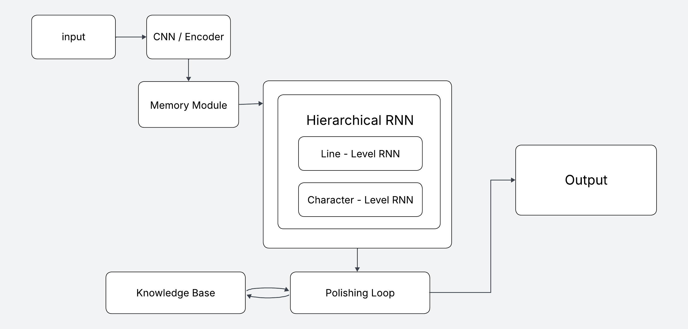
Proposed Solution
Notes:
10

Slide 11
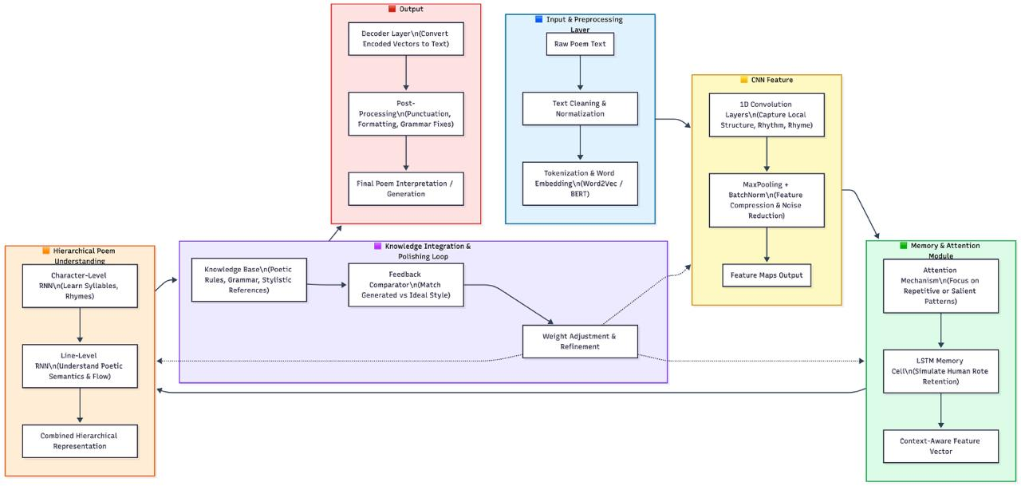

Slide 12
Advantages
Captures human-like learning through explicit memory and repetition modules.
Provides fine-grained interpretation using hierarchical (line and character-level) processing.
Adapts continuously and improves outputs via human feedback (RLHF).
Handles long-term dependencies and context recall better than standard RNNs/transformers.
Knowledge base integration enriches interpretation with rules, semantics, and poetic devices.
Automates both analysis and generation, not just poem writing.
Notes:
12

Slide 13
Overcoming Drawbacks of Existing Systems
Solves shallow understanding—traditional models lack deep semantic or contextual memory.
Reduces static outputs—offers dynamic, user-aligned interpretation through feedback.
Deals with limited context recall—uses external memory to revisit earlier lines/poems.
Exceeds simple pattern matching—incorporates genuine reasoning over poetic devices and meanings.
Enables personalized, flexible outputs in response to new user inputs and annotations.
Notes:
13

Slide 14
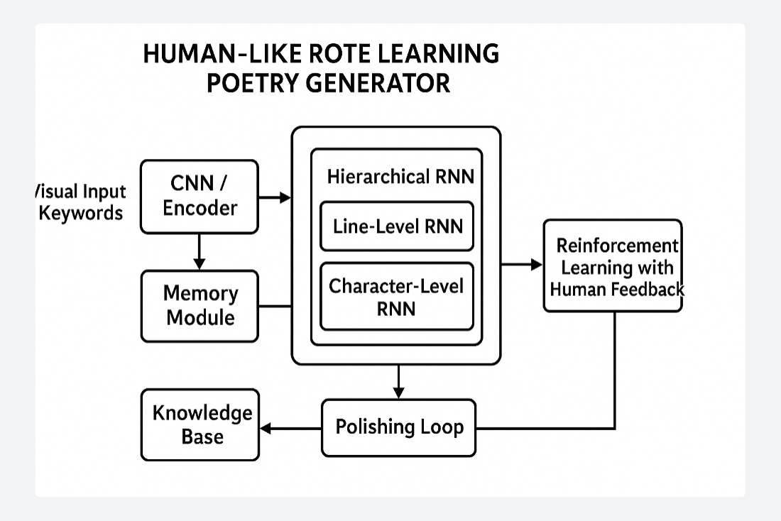
Conclusion
This proposed solution for “A CNN-Based Poem Learning and Interpretation Model Inspired by Human Rote Learning” establishes a structured, multi-stage system that closely mimics human learning. By integrating CNN/text encoding, memory-augmented modules, hierarchical neural networks, and a knowledge base, the model can interpret, analyze, and generate poetry with increasing alignment to human creativity and understanding. The addition of polishing loops and human feedback ensures iterative improvement, making the system robust and adaptable for both academic study and practical deployment. This architecture not only automates poem interpretation but also deepens the connection between artificial intelligence and literary analysis, reflecting the true essence of rote human learning in modern poetic AI.

Slide 15
References
Zadeh, A., Liang, P. P., Mazumder, N., Poria, S., Cambria, E., & Morency, L. P. (2018). Multimodal Language Analysis in the Wild: CMU-MOSEI Dataset and Interpretable Dynamic Fusion Graph. Proceedings of the 56th Annual Meeting of the Association for Computational Linguistics (ACL 2018).
https://arxiv.org/abs/1806.06157
Baltrušaitis, T., Ahuja, C., & Morency, L. P. (2019). Multimodal Machine Learning: A Survey and Taxonomy. IEEE Transactions on Pattern Analysis and Machine Intelligence.
https://arxiv.org/abs/1705.09406
Busso, C., Bulut, M., Lee, C. C., Kazemzadeh, A., Mower, E., Kim, S., ... & Narayanan, S. (2008). IEMOCAP: Interactive Emotional Dyadic Motion Capture Database. Language Resources and Evaluation, 42(4), 335–359.
https://sail.usc.edu/iemocap/
Poria, S., Hazarika, D., Majumder, N., Naik, G., Cambria, E., & Mihalcea, R. (2017). A Deeper Look into Sarcastic Tweets using Deep Convolutional Neural Networks. Proceedings of COLING 2016, the 26th International Conference on Computational Linguistics.
https://arxiv.org/abs/1610.08815
Yiyuan Zhang, Kaixiong Gong, Kaipeng Zhang, Hongsheng Li, Yu Qiao, Wanli Ouyang, Xiangyu Yue. Meta-Transformer: A Unified Framework for Multimodal Learning.
https://arxiv.org/pdf/2307.10802

